Slide 1

Introduction to Software Business Product management
Week 1 Day 2
Led by:
Emily Crose
Oakland University
Notes:
Include VLANs?

Slide 2





Day 1 recap

Slide 3
Contact info
ecrose@oakland.edu

Slide 4


Question or Clarifications?

Slide 5

Networking

Slide 6

What Does Your Home Network Look Like?
Notes:
Let’s have a quick discussion. What does your home network look like? What kind of devices are on your network?

Slide 7
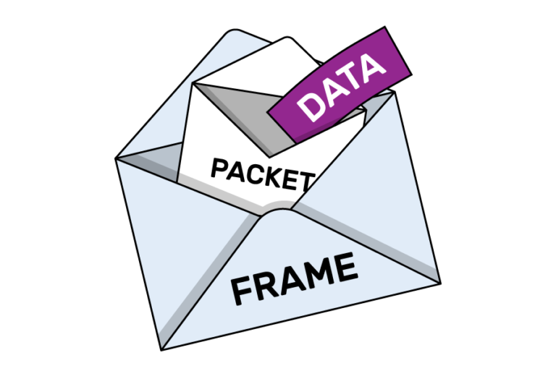
Packets

Slide 8
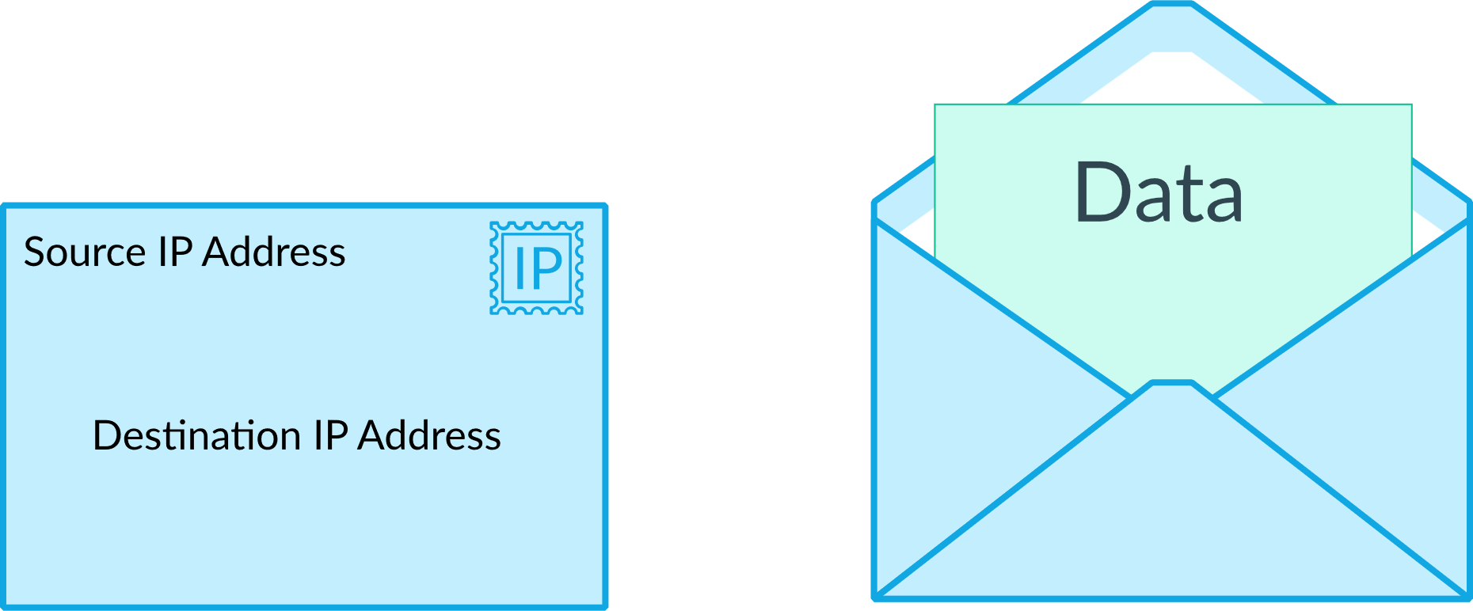

Slide 9
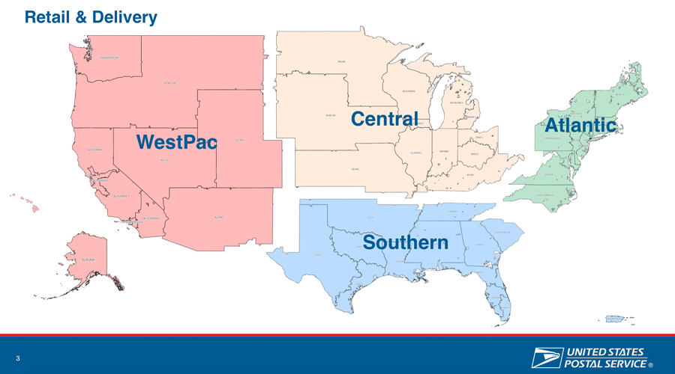

Slide 10
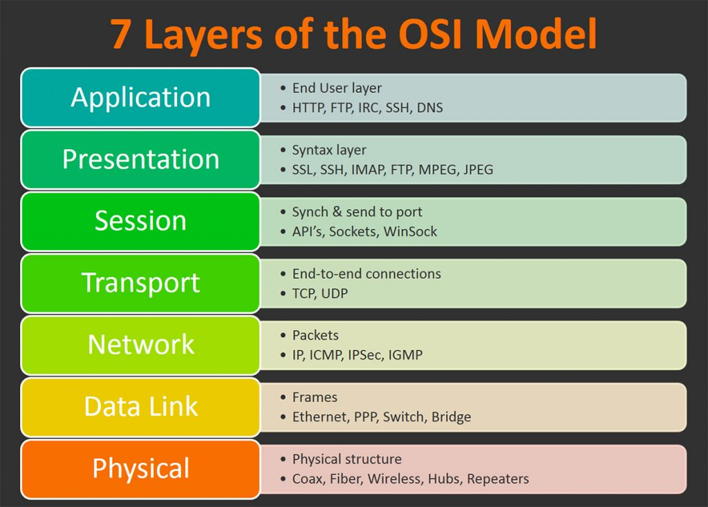

Slide 11
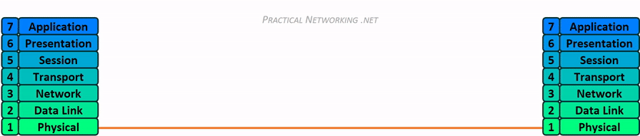
Network Transmission

Slide 12

Layer 1- Physical
Media Layer

Slide 13
Networking Hardware
Purpose
Provides a physical medium for transporting raw information
Wireless Antenna
Cat5 (Ethernet) Cables
Coaxial Cables
Fiber Optic Cables
Network Hubs
Network Repeaters

Slide 14

Layer 2 - Data Link
Media layer

Slide 15
Layer 2
Purpose
Provides error-free transfer of data frames from one node to another via the physical layer
Physical
Network Switch
Network Bridge
Logical
“Frames”

Slide 16
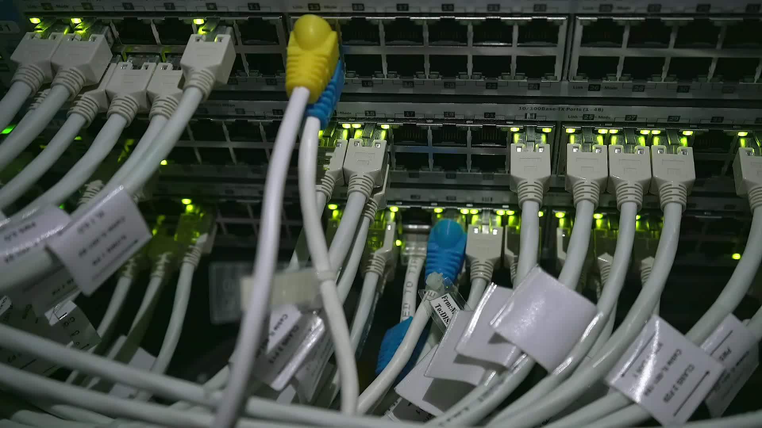
Layer 3 - Network
Media Layer

Slide 17
Layer 3
Purpose
Controls the operations of the subnet.
Decides which physical path data will take
Physical
Router
Logical (Protocols)
IP
ICMP
IPSec
IGMP

Slide 18
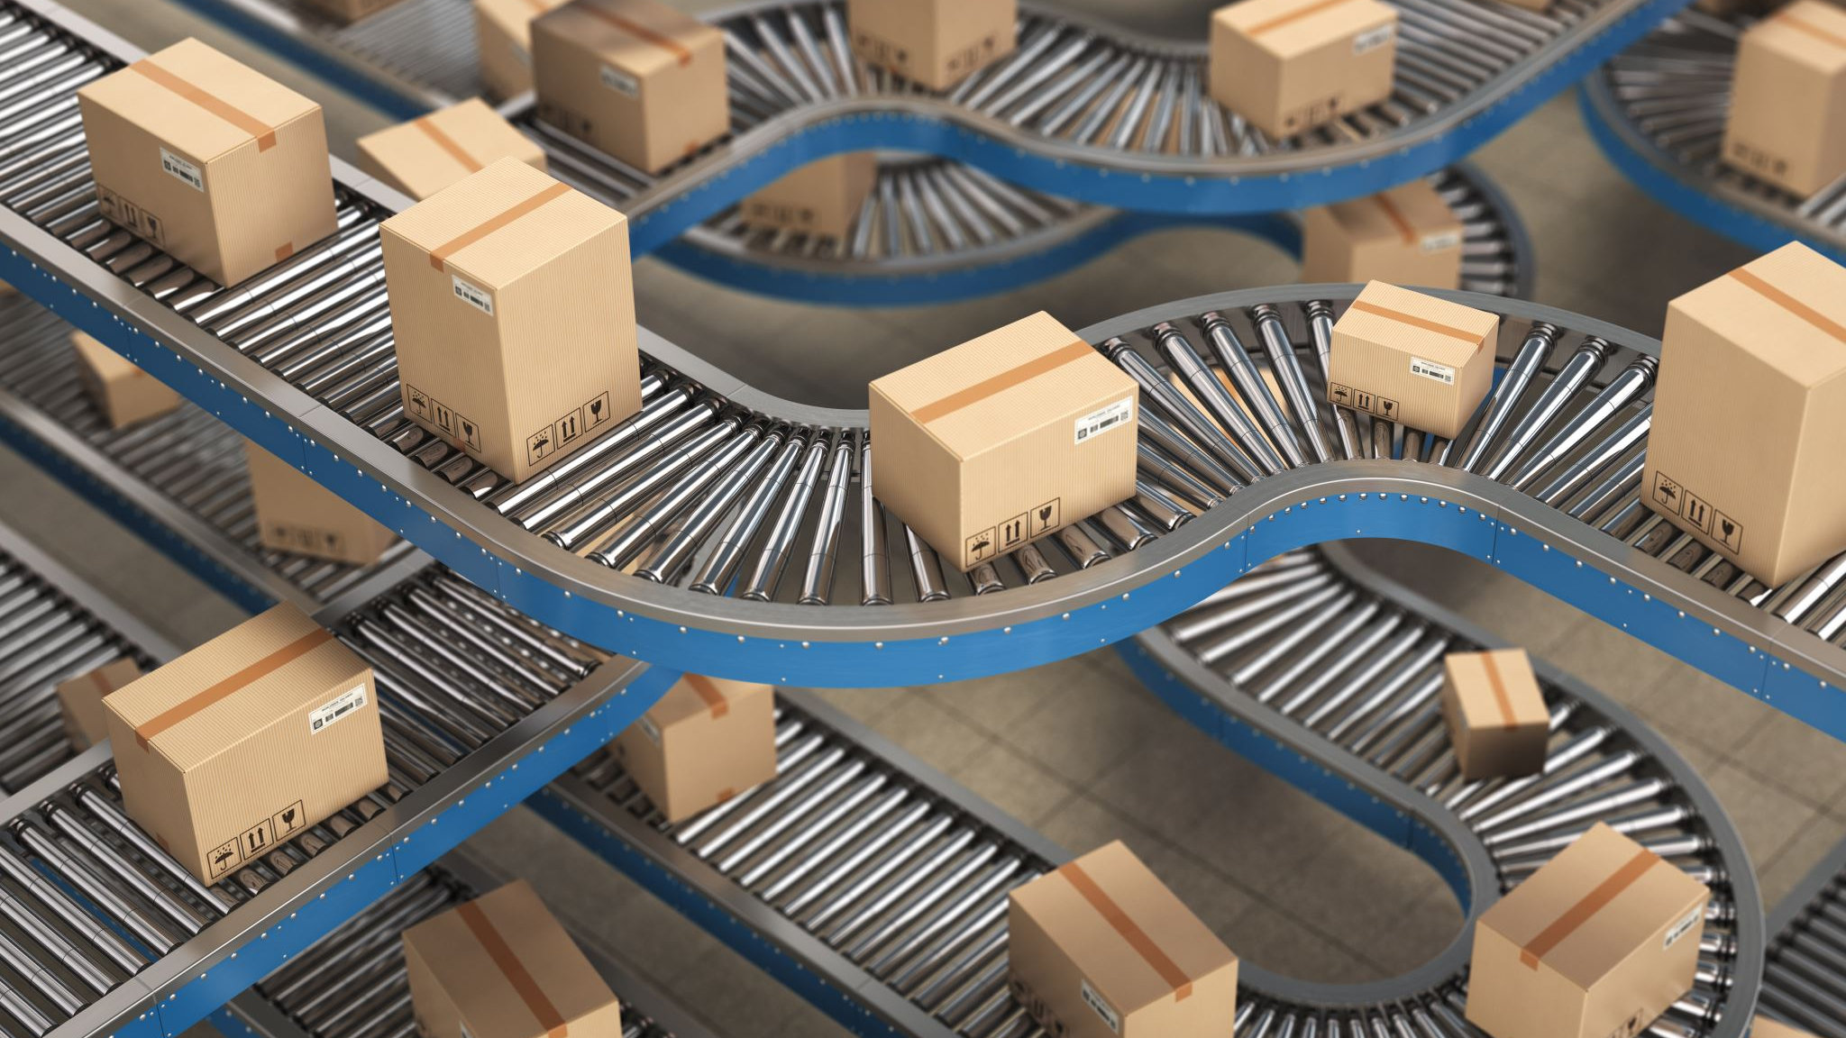
Layer 4 - Transport
Host Layer

Slide 19
Layer 4
Purpose
Ensures that messages are delivered in sequence without losses, errors or duplications
Logical
TCP
UDP

Slide 20
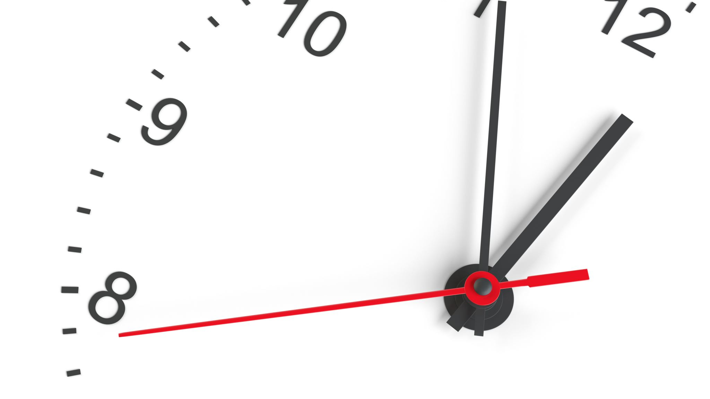
10 minute break

Slide 21
TCP VS. UDP

Slide 22
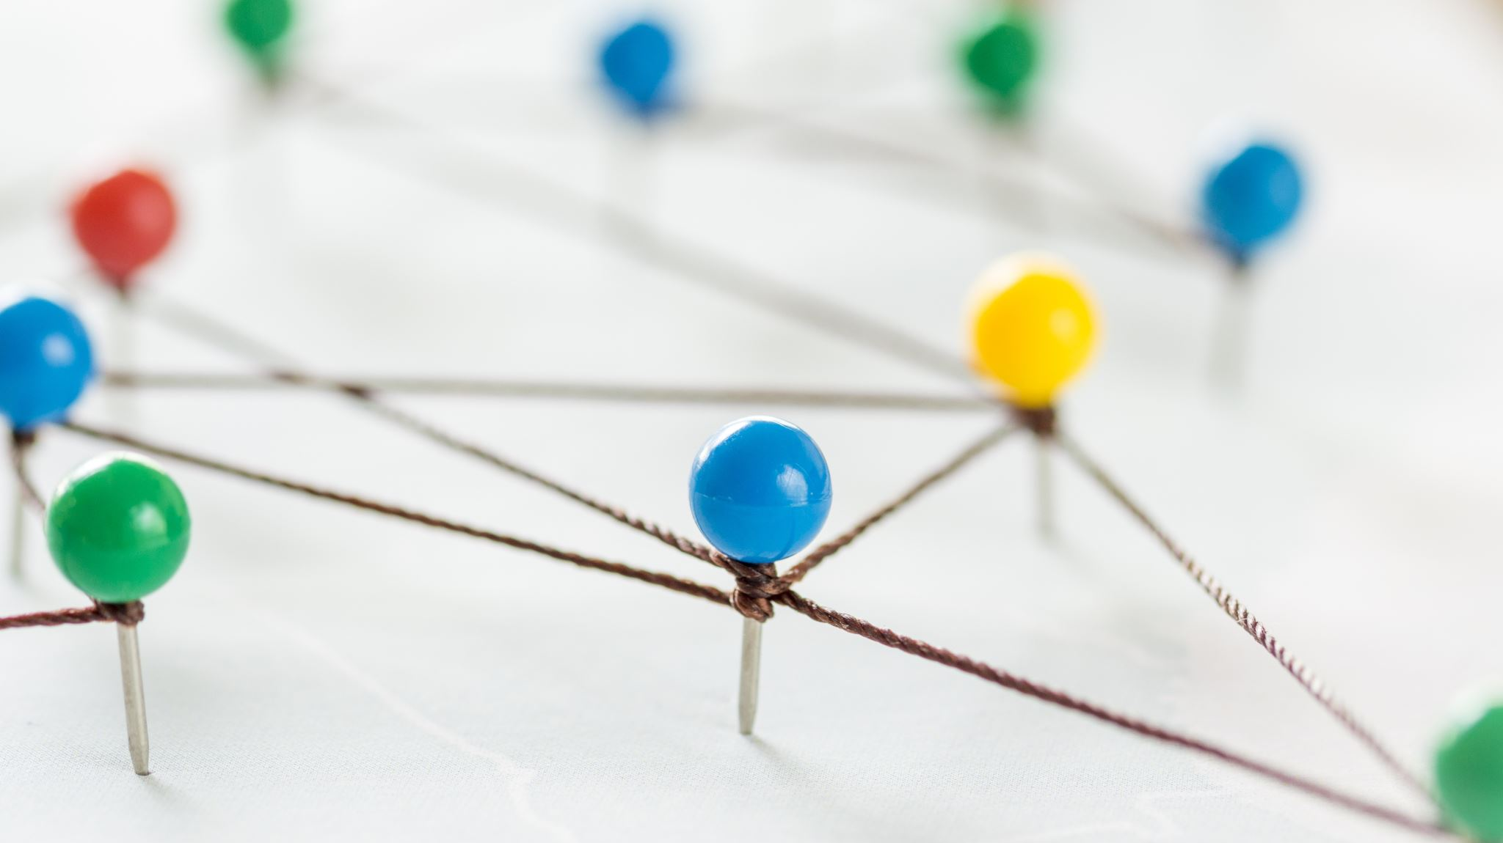
Stateful vs. Stateless Networking

Slide 23
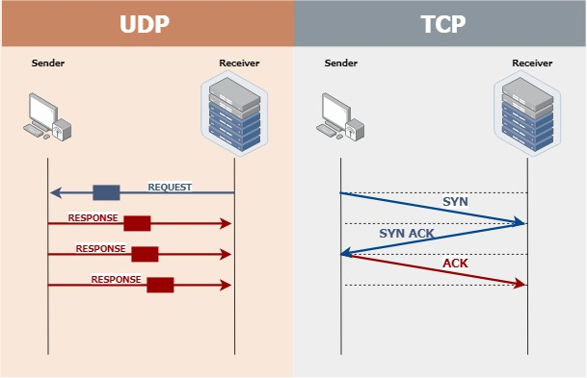

Slide 24
TCP Handling

Slide 25
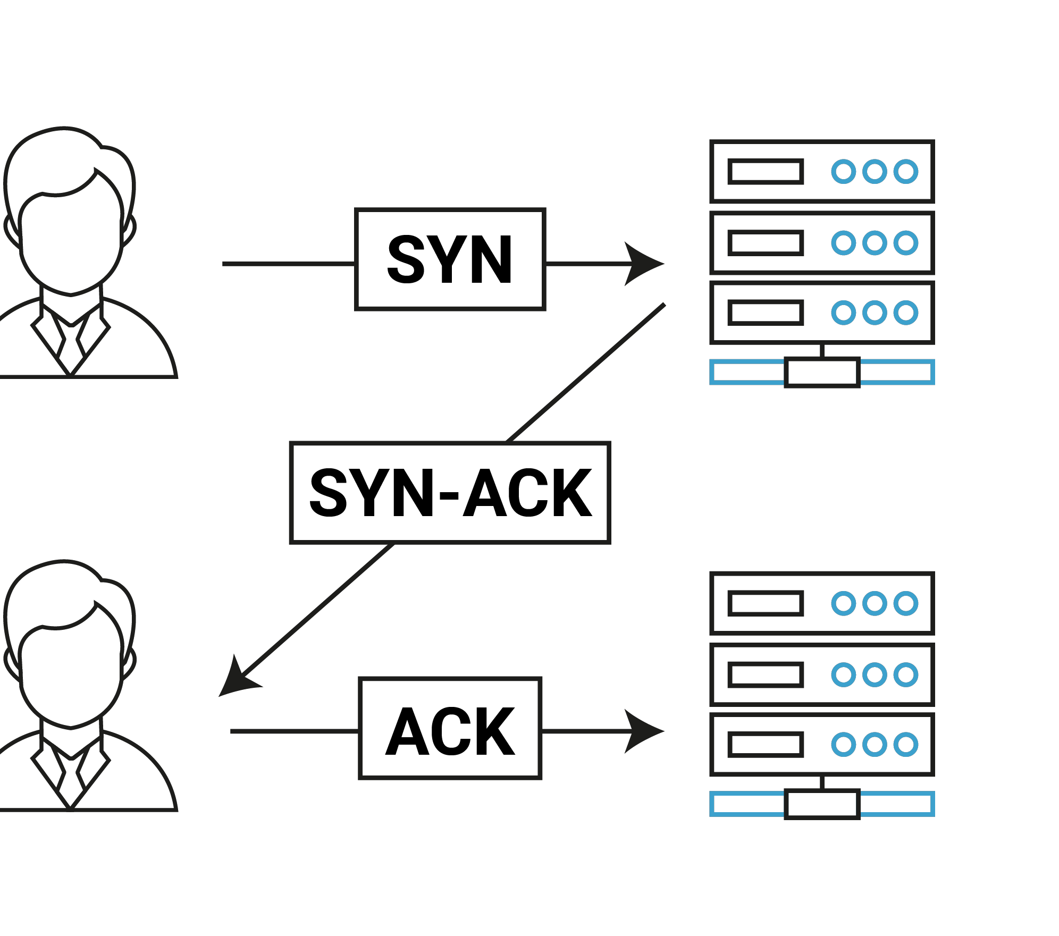
TCP 3-Way Handshake

Slide 26
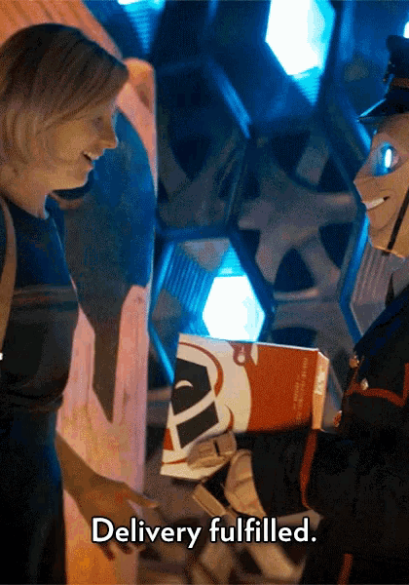
Explain TCP In A Gif

Slide 27
UDP Handling

Slide 28
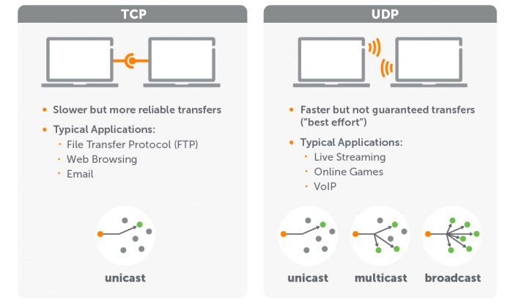

Slide 29

Explain UDP In A Gif

Slide 30
Discussion: TCP Apps & UDP Apps
Moodle
TCP or UDP?
VoIP
TCP or UDP?
YouTube
TCP or UDP?
SWIFT Money Transfers
TCP or UDP?

Slide 31
Layer 5 – Session
Host layer

Slide 32
Layer 5
Purpose
Allows the establishment of sessions between processes
Protocols
RPC
SQL
NFS
Netbios

Slide 33

Layer 6 – Presentation
Host layer

Slide 34
Layer 6
Purpose
Formats data bound for the application layer (layer 7)
Protocols
JPG
ASCII
ANSI
GIF
WEBP

Slide 35
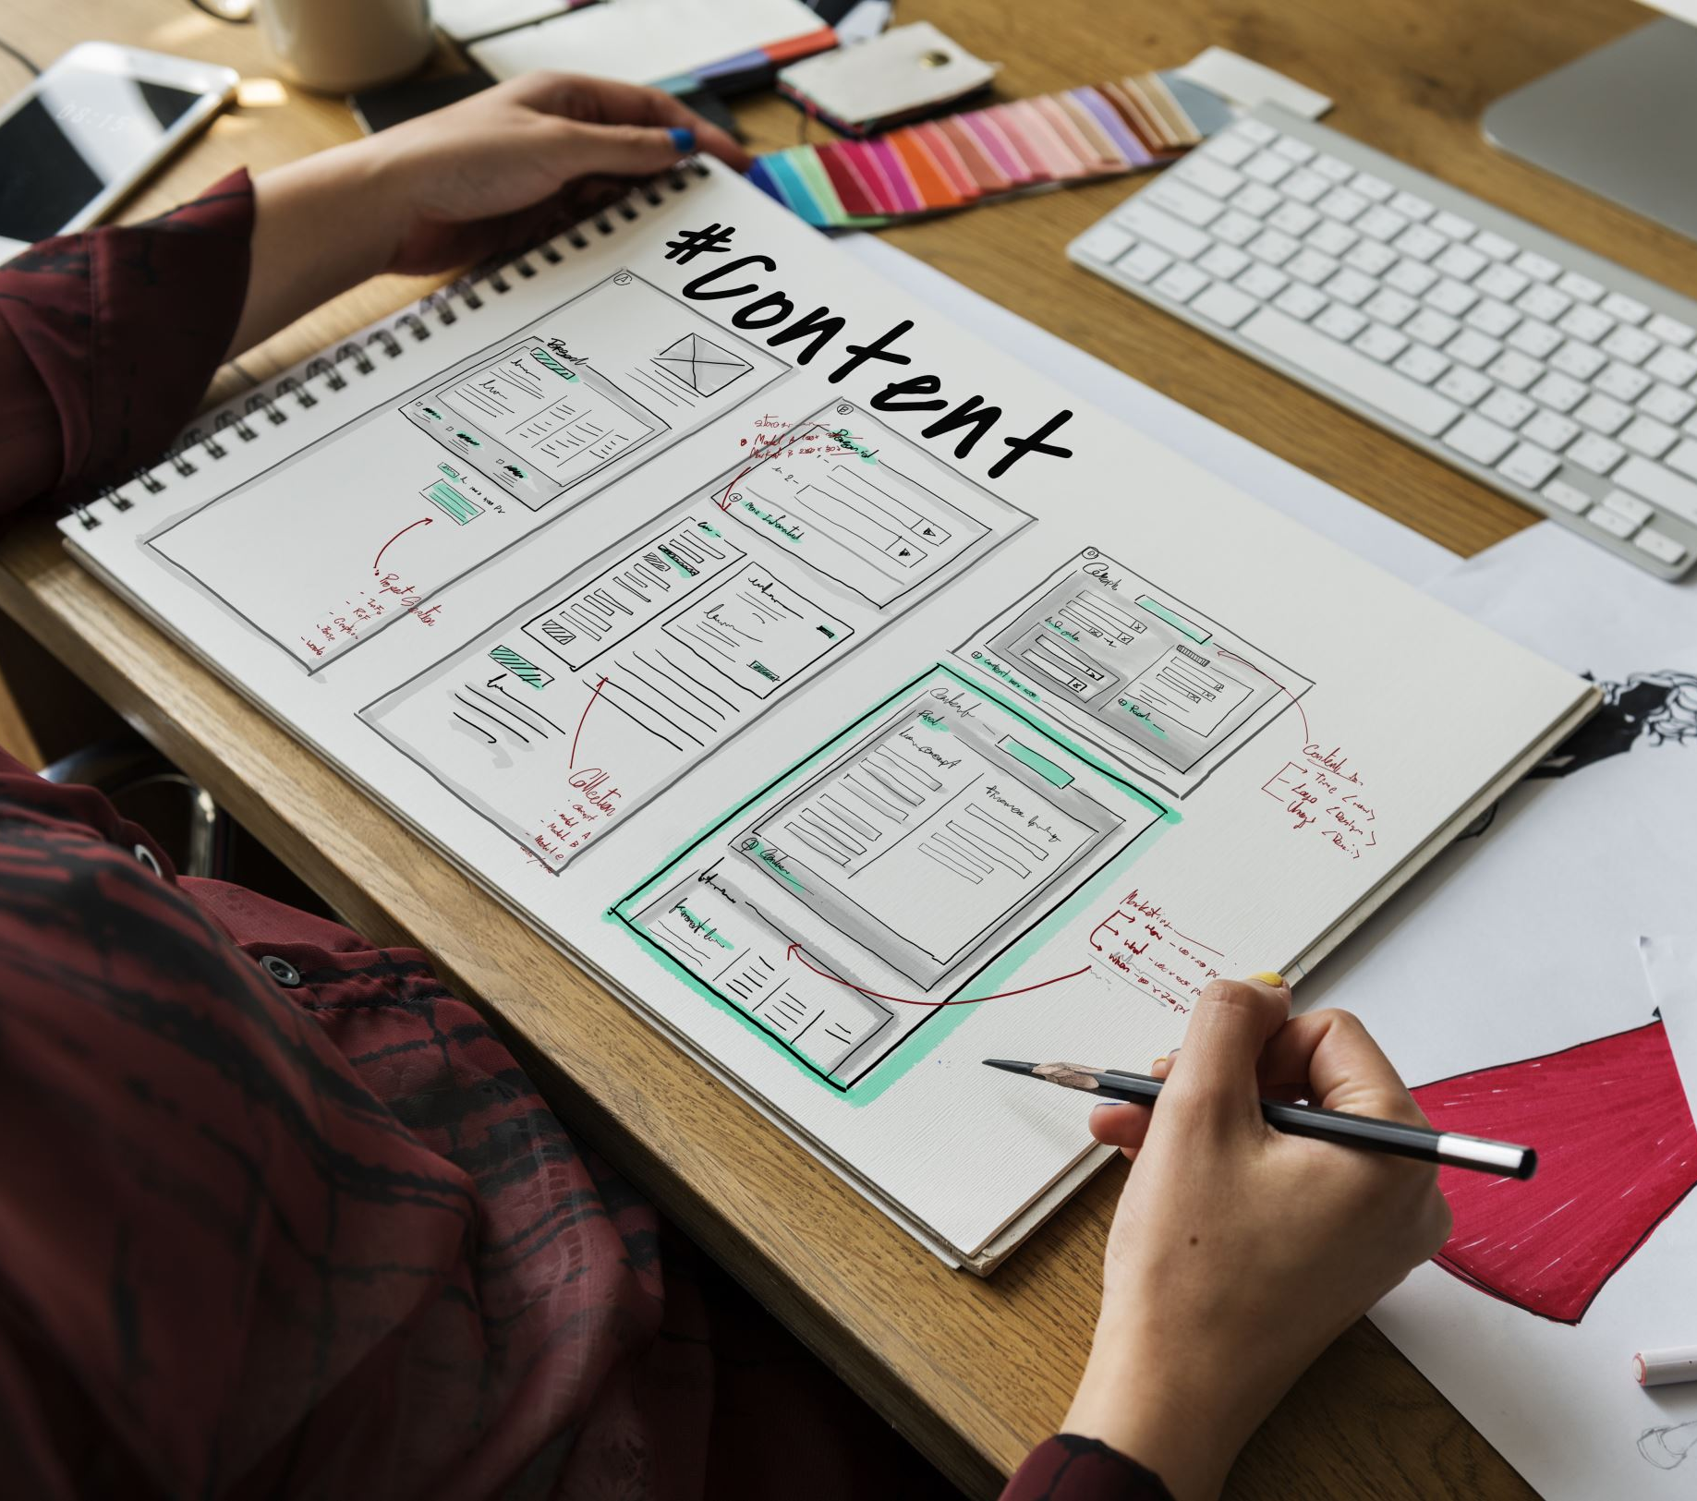
Layer 7 – Application
Host layer

Slide 36
Layer 7
Purpose
Interface layers for users to access network resources
Protocols
SMTP
HTTP
Wiki
Microsoft Word

Slide 37
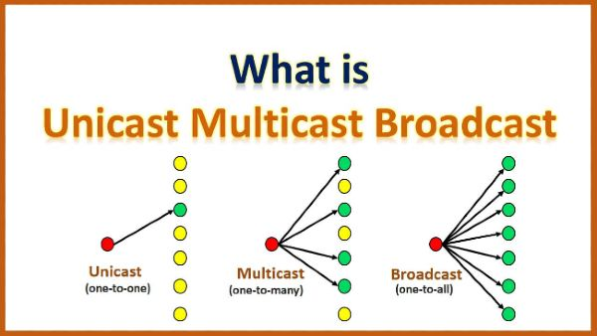

Slide 38

Shall We Play A Game?
https://static-labs.tryhackme.cloud/sites/osi-model-game/
Notes:
Let’s play a little network protocol game and see if we can remember the 7 layers of the OSI model!

Slide 39

Name Resolution

Slide 40
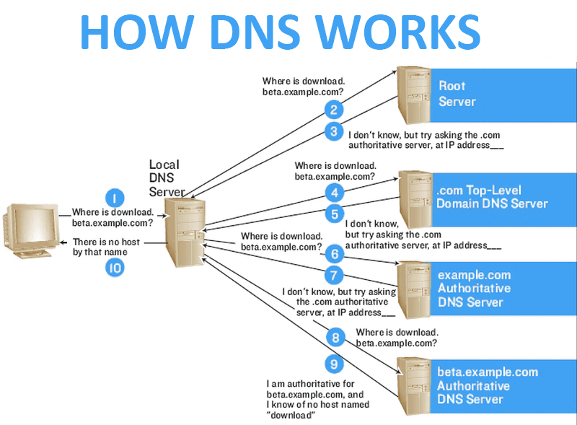
DNS

Slide 41

DNS: TCP or UDP?

Slide 42

Problem: How Do We Move Information?

Slide 43
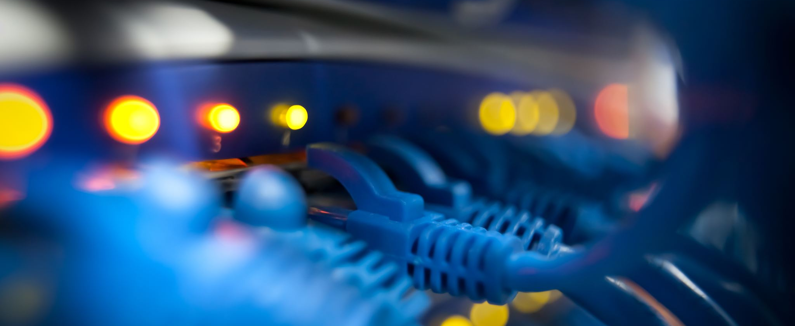
LANs and WANs

Slide 44
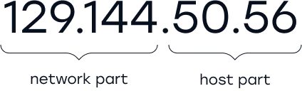
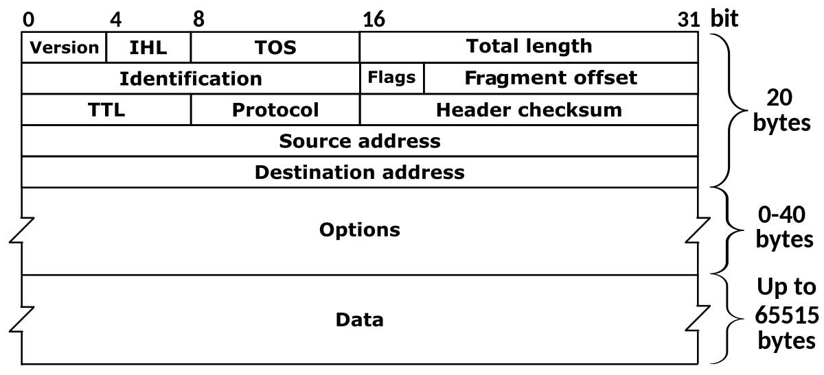
Network Operation

Slide 45
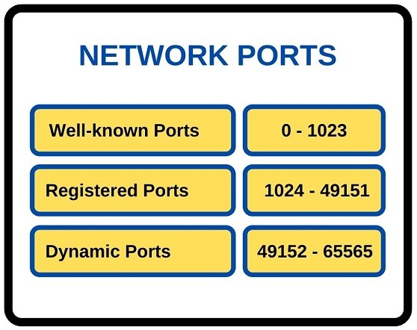
Network Ports

Slide 46
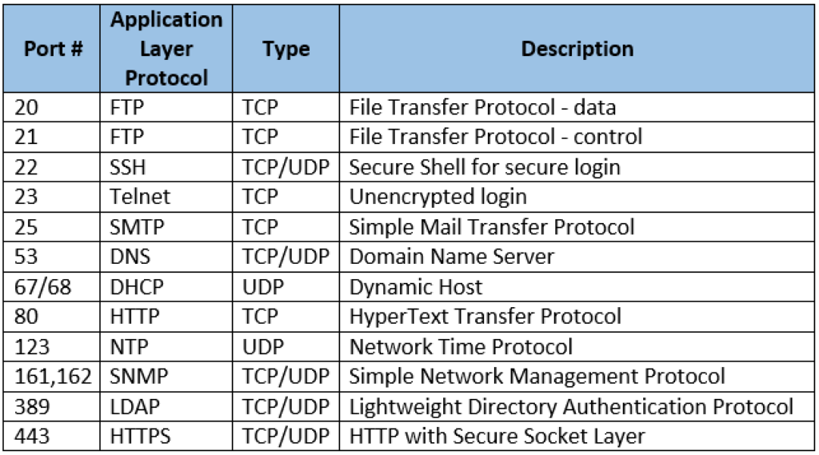
Common Ports

Slide 47
10 minute break

Slide 48
Local Area Network (LAN)
Allows connection to other nearby network-connected systems
You probably use some of these devices!
Amazon firestick
Google Chromecast
Apple TV
More protective of local information?

Slide 49
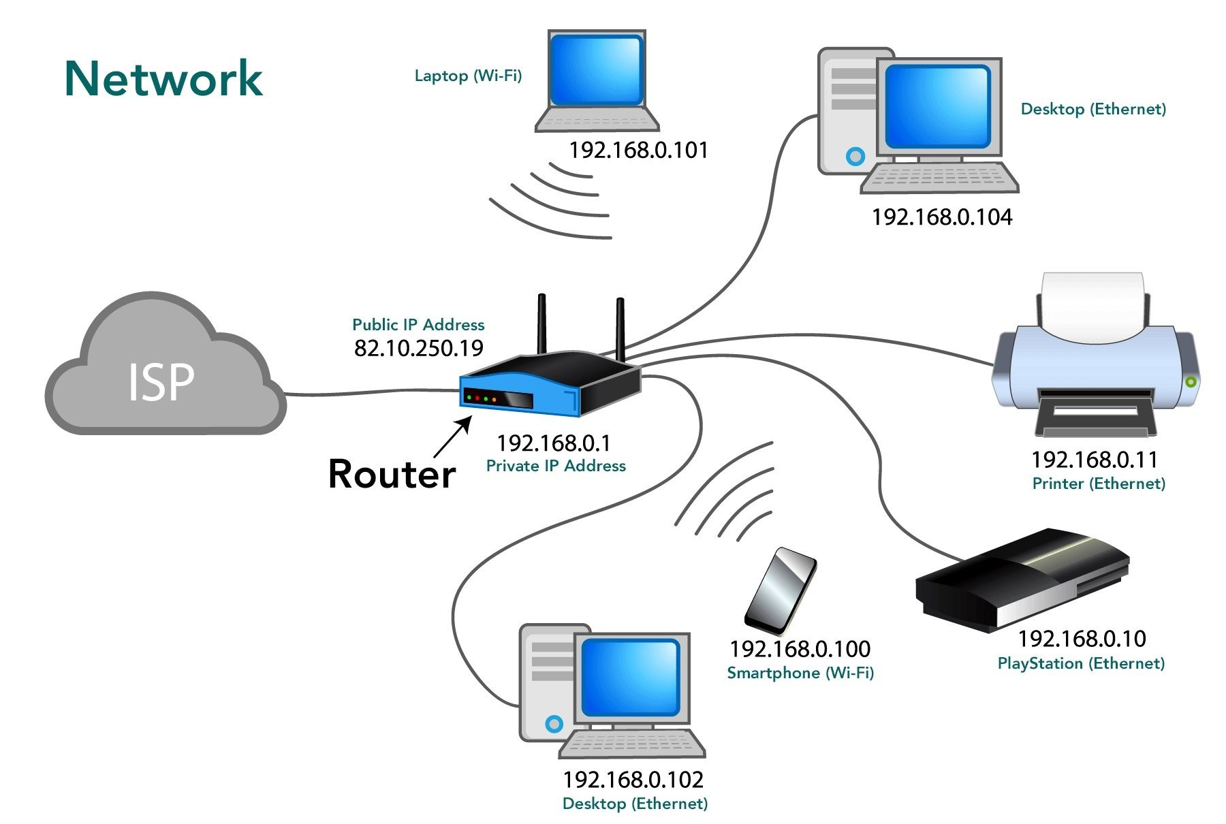
Basic Network Topology

Slide 50
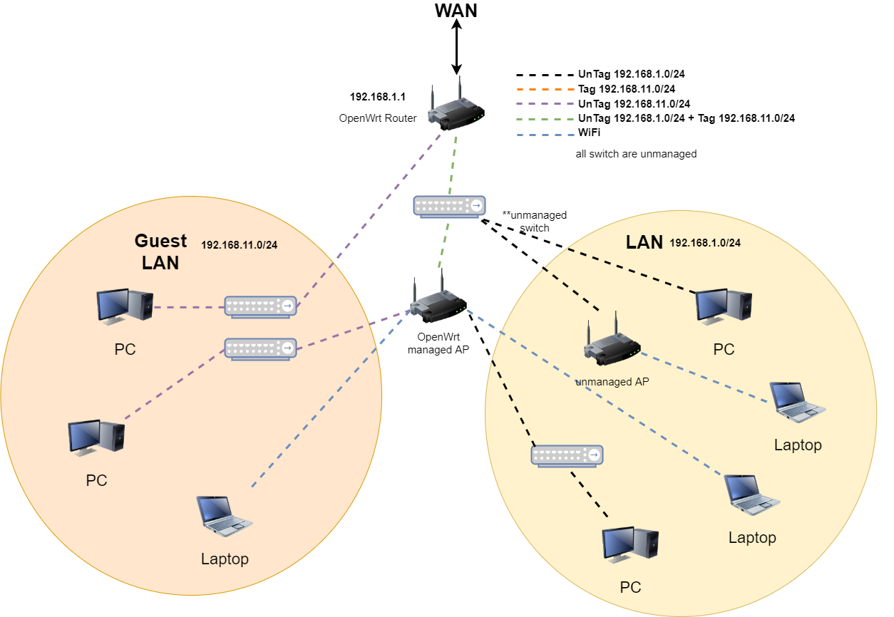

Slide 51
Wide Area Network (WAN)
Allows connection to remote hosts
Websites
Remote backups/repositories
VPNs enable access to remote LANs

Slide 52
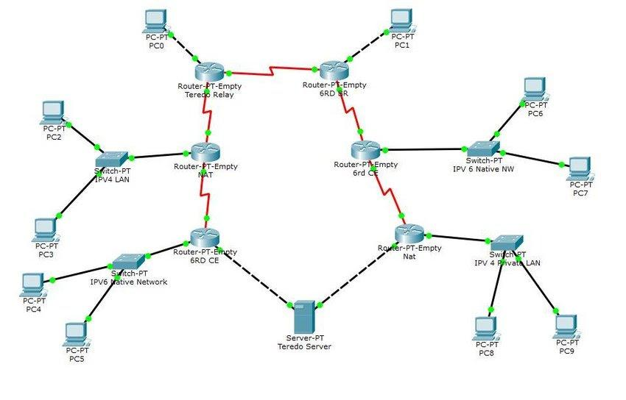
Complex Network Topology

Slide 53
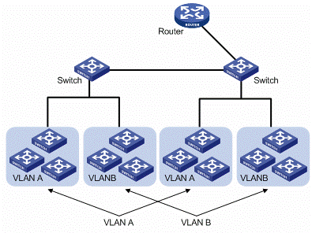
LANs and VLANs

Slide 54
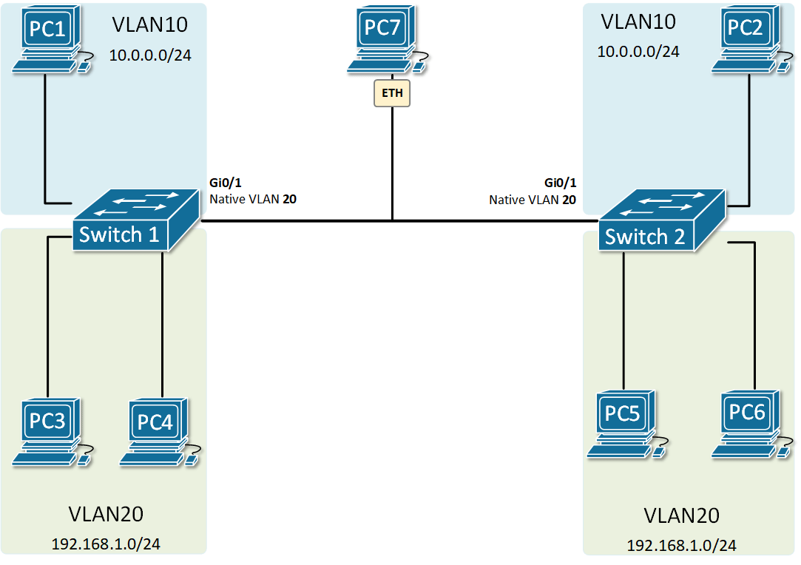
Trunk Native VLAN

Slide 55

How Do Apps Access Information?

Slide 56
Local & Remote Information
Local filesystem
Remote filesystem
Repositories
Databases
Local hard drive
Hard drive on another computer
Structured data
Typically holds frequently changing information
SQL, MSAccess, etc.

Slide 57
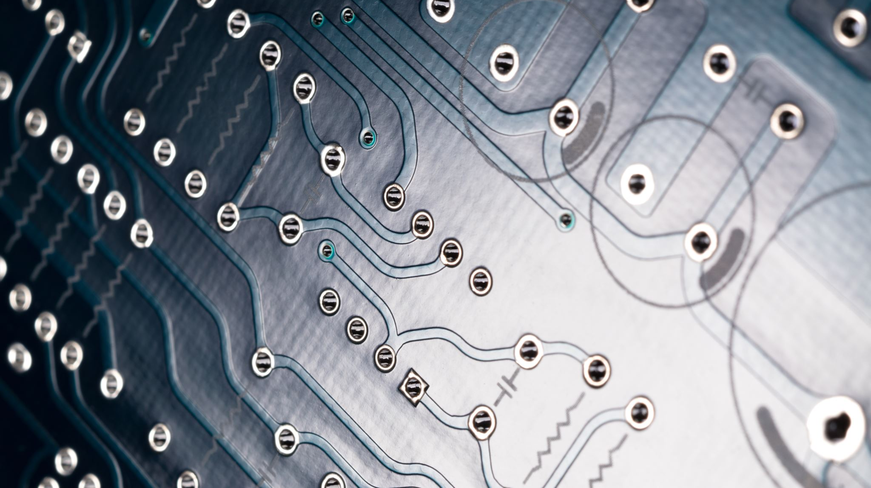
Software Underpins All Of This!

Slide 58
Day 2 Recap

Slide 59
Question or Clarifications?

Slide 60
Day 3 Preview

Slide 61
Instructor Contact Info
ecrose@oakland.edu

